Slide 1
Routing I

Slide 2
Routers and How They Work
A router joins two or more networks and passes packets from one network to another
Routers can do the following:
Connect dissimilar networks (LANs and WANs)
Interpret Layer 3 and often Layer 4 addressing
Determine the best path for data to follow from point A to point B
Reroute traffic if the path of first choice is down but another path is available

Slide 3
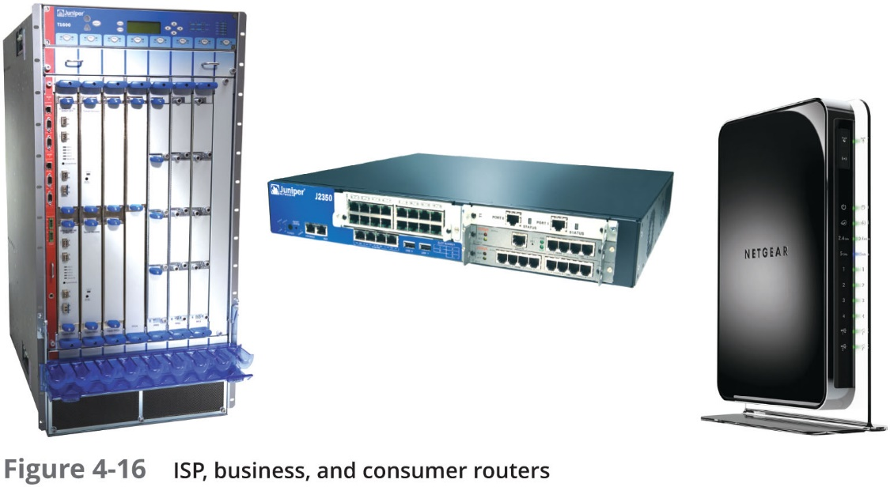
Routers and How They Work

Slide 4
Routers and How They Work
Routers may perform any of the following optional functions:
Filter broadcast transmissions
Prevent certain types of traffic from getting to a network
Support simultaneous local and remote connectivity
Provide high network fault tolerance through redundant components such as power supplies
Monitor network traffic and report statistics
Diagnose internal or other connectivity problems and trigger alarms

Slide 5
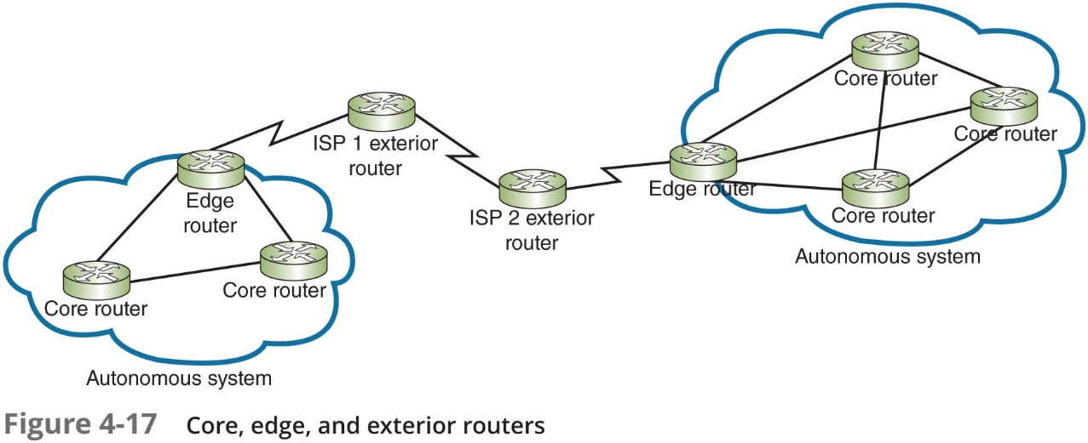
Routers and How They Work
Router categories:
Core routers, also called interior routers—Direct data between networks within the same autonomous system (A S)
Edge routers, or border routers—Connect an autonomous system with an outside network
Exterior routers—Refers to any router outside the organisation’s A S
Direct data between autonomous systems

Slide 6
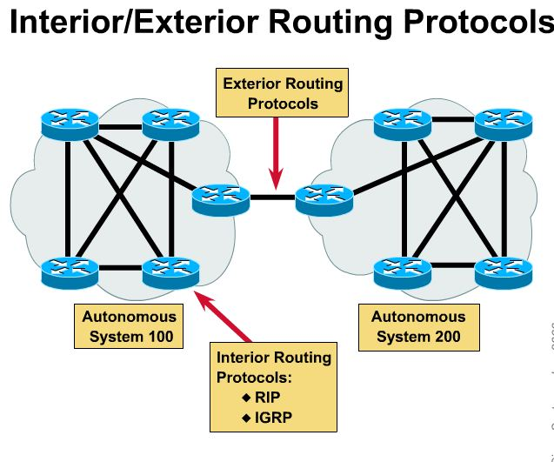
Autonomous Systems
An Autonomous System is a collection of networks under a common administration (a single organisation, ISP or systems administrator) and sharing a common routing strategy.
Typically the world wide organisation ICANN, the ISP, or the administrator assigns a unique AS number to the Autonomous System.
The Autonomous System number uniquely distinguish it from other Autonomous Systems around the world.
Each Autonomous Systems has its own set of rules and policies.

Slide 7
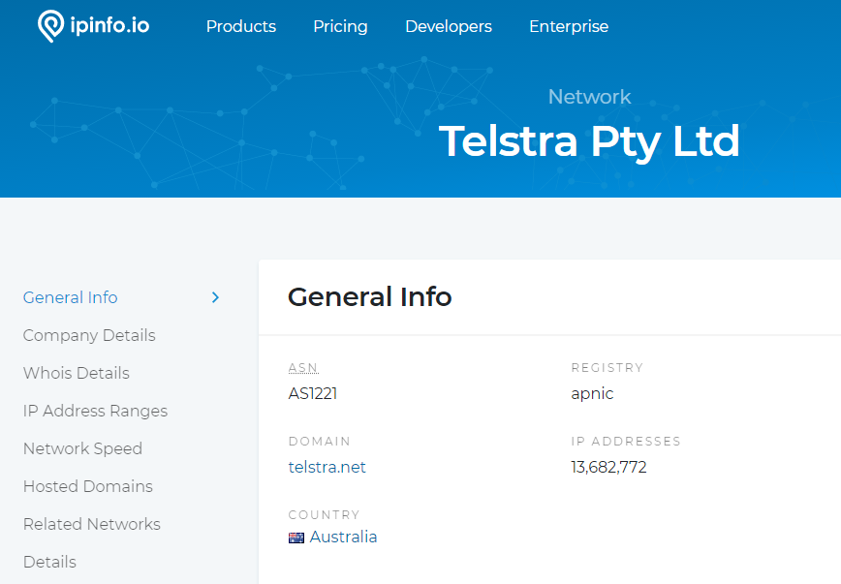

Slide 8
Multilayer Switches
Layer 3 switch—Capable of interpreting Layer 3 data and works much like a router:
Usually faster and less expensive
Primary difference is the way the hardware is built
Layer 4 switch—Capable of interpreting Layer 4 data:
Also known as content or application switches
Enables switch to perform advanced filtering, keep statistics, and provide security functions
Typically used as part of a network’s backbone

Slide 9
Routing Tables
Routing table—A database that maintains information about where hosts are located and the most efficient way to reach them
Routers rely on them to identify which router is the next hop to reach a particular destination host
Routing tables contain IP addresses and network masks that identify a network that a host or another router belongs to

Slide 10
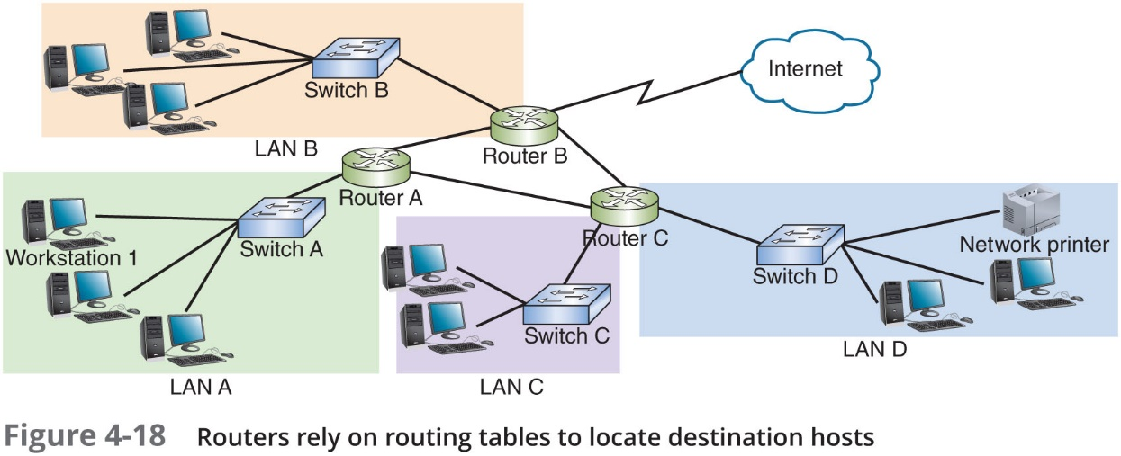
Routing Tables

Slide 11
Routing Path Types
Static routing—Network administrators configures a routing table to direct messages along specific paths
Example—A static route between a small business and its I S P
Dynamic routing—Automatically calculates the best path between two networks and maintains this information in a routing table
Router can detect problems with failed or congested routes and reroute messages through a different path

Slide 12
The route Command
The route command allows you to view a host’s routing table:
On a Linux or UNIX system, use the command route
On a Windows-based system, use the command route print
On a Cisco I O S, use the command show ip route

Slide 13
Routing Metrics
Routing metrics—Properties of a route used by routers to determine the best path to a destination:
Hop count
Theoretical bandwidth and actual throughput
Delay, or latency, on a potential path
Load, or the traffic or processing burden
M T U (maximum transmission unit) or the largest I P packet size in bytes allowable without fragmentation
Routing cost, or a value assigned to a particular route
Reliability of a potential path
Topology of a network

